Slide 1

FILM SUGGESTER
Presented By :
Anuvind Pradeep
1NH17CS015
Department of CSE

Slide 2
Objectives of the course
This mini project has been basically programmed using JAVA. From this course, we will have a short research on the concept that is used for creation of a Graphical User Interface (GUI). i.e., Swing. Swing is a library of JAVA that provides many tools which is used for creation of a GUI.
We can also have a glance about MySQL, which is the database that is being used in this project. MySQL plays a very important role in storage management in this project.
We have also learnt how to connect JAVA to MySQL using a tool called JDBC. In order to perform operations on the MySQL table via JAVA, JDBC is required.

Slide 3
ABSTRACT
Film Suggester is the project which uses java as the programming language.
Having said that, it uses majority of the object-oriented concepts like classes and objects, inheritance, polymorphism, stat abstraction etc.
The project contains both backend and front-end connectivity. It also uses the concept of Iostreams and file handling. Database is implemented through MySQL which acts as backend connectivity to the project. As the front end, swing and java AWT are used for presentable look and feel.

Slide 4
Objectives of the project
The main aim of the project is to build an engine which basically searches the set of movies when the user enters a movie his/her choice.
Creating a database that holds the information about users and then giving an username and password to login.
The goal is to predict the previous users who have also watched the same set of movies and through the past information, the now the user currently searching for a movie should get a certain set of movies as a recommendation.

Slide 5
3. The recommendation should happen from the data retrieved from the database.
4. Movie booking should be confirmed when the bank details authentication is done.

Slide 6
Problem Statement
As we all know, technology changes in some or the other aspect every moment.
This applies to various fields that also applies to the field of movies. There are various applications available in various platforms to view, book, recommend movies.
They use various algorithms in order to develop the apps. FILM SUGGESTER project also tries to store various details about the users accessing it as well the list of movies that is used to display the searched movie as well as recommend the movies based on various aspects.

Slide 7
Problem Statement
4. The movie searched along with the recommended movies are displayed to the user among which he/she can select based on genre it belongs to.
5. This project mainly focuses on recommending the movies when the user enters a movie. The recommendation contains various aspects or attributes such as genre, director, rating etc. In order to store the user data, a file of .log format is used.
6. Database connectivity is also done to store various types of data and also used to perform certain set of queries.

Slide 8
Functionality
This helps the user to watch movies they might be interested in.
Provides the searching facility for various fields like selecting genre the user likes.
Keep track of the processes, store it in the database for future references.
User details along with the credentials are stored.
Online payments are available.

Slide 9
Methodology
Planning
System Analysis
Design
Specification
Development
Testing

Slide 10
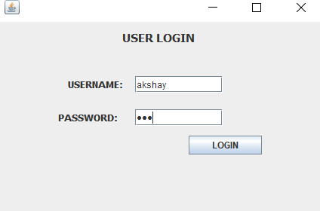
USER LOGIN

Slide 11
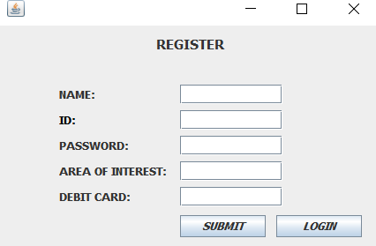
REGISTER

Slide 12
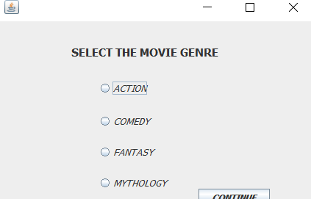
MOVIE GENRE

Slide 13
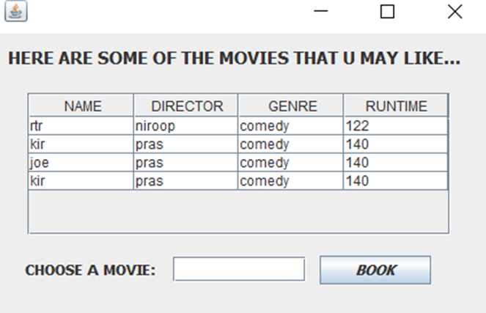
MOVIE SUGGESTIONS

Slide 14
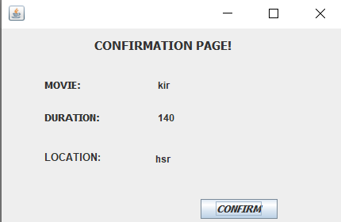
CONFIRMATION PAGE

Slide 15
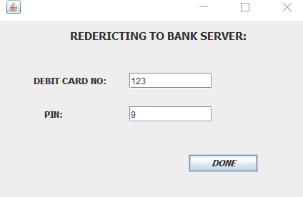
PAYMENT PAGE

Slide 16
OBJECTIVES ACHIEVED
We have learnt to use Java to create applications.
We have created a functional library management software.
We have learned to create an user friendly front-end using swing.
We have learned to create and use back-end using MySQL and JDBC.
We have used Mahout libraries to implement a user recommender system to recommend MOVIES.

Slide 17
THANK YOU

